Slide 1
Selected Topics in Computational Intelligence I
Session Enrichment 5
Implementation ANFIS

Slide 2
Neural Networks and Fuzzy Logic
Neural networks and fuzzy logic are two complimentary technologies
Neural networks can learn from data and feedback
– It is difficult to develop an insight about the meaning associated with each neuron and each weight
– Viewed as “black box” approach (know what the box does but not how it is done conceptually!)

Slide 3
Online (pattern mode) VS Batch mode of BP learning
Two ways to adjust the weights using backpropagation
– Online/pattern Mode: adjusts the weights based on the error signal of one input-output pair in the trainning data.
• Example: trainning set containning 500 input-output pairs, this mode BP adjusts the weights 500 times for each time the algorithm sweeps through the trainning set. If the algorithm sweeps converges after 1000 sweeps, each weight adjusted a total of 50,000 times

Slide 4
Online (pattern mode) VS Batch mode of BP learning (cont.)
– Batch mode (off-line): adjusts weights based on the error signal of the entire training set.
• Weights are adjusted once only after all the trainning data have been processed by the neural network.
• From previous example, each weight in the neural network is adjusted 1000 times.

Slide 5
Neural Networks and Fuzzy Logic (cont)
Fuzzy rule-based models are easy to comprehend (uses linguistic terms and the structure of if-then rules)
Unlike neural networks, fuzzy logic does not come with a learning algorithm
– Learning and identification of fuzzy models need to adopt techniques from other areas
Since neural networks can learn, it is natural to marry the two technologies.

Slide 6
Neuro- Fuzzy System
Neuro-fuzzy system can be classified into
three categories:
A fuzzy rule-based model constructed using a supervised NN learning technique
A fuzzy rule-based model constructed using reinforcement-based learning
A fuzzy rule-based model constructed using NN to construct its fuzzy partition of the input space

Slide 7
ANFIS: Adaptive Neuro-Fuzzy Inference Systems
A class of adaptive networks that are functionally equivalent to fuzzy inference systems.
ANFIS architectures representing both the Sugeno and Tsukamoto fuzzy models

Slide 8
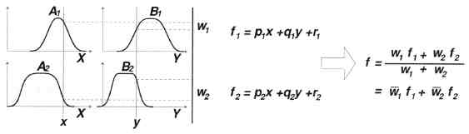
A two-input first-Order Sugeno Fuzzy Model with two rules

Slide 9
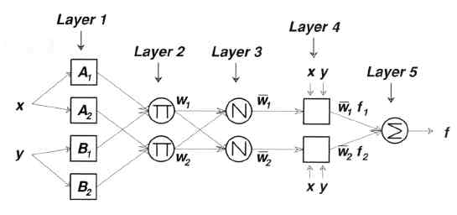
Equivalent ANFIS architecture

Slide 10
ANFIS Architecture
Assume - two inputs X and Y and one output Z
Rule 1: If x is A1 and y is B1,
then f1 = p1x + q1y +r1
Rule 2: If x is A2 and y is B2,
then f2 = p2x + q2y +r2

Slide 11
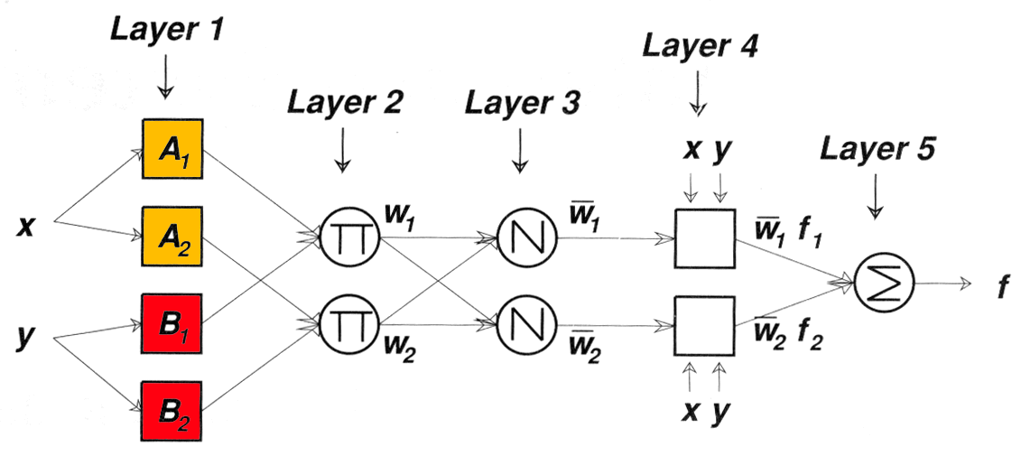
ANFIS Architecture: Layer 1
Every node i in this layer is an adaptive node with a node function
O1,i = mAi (x), for I = 1,2, or O1,i = mBi-2 (y), for I = 3,4
Where x (or y) is the input to node i and Ai (or Bi) is a linguistic label
** O1,i is the membership grade of a fuzzy set and it specifies the
degree to which the given input x or y satisfies the quantifies

Slide 12
ANFIS Architecture: Layer 1 (cont.)
Typically, the membership function for a fuzzy set can be any parameterized membership function, such as triangle, trapezoidal, Guassian, or generalized Bell function.
Parameters in this layer are referred to as Antecedence Parameters

Slide 13
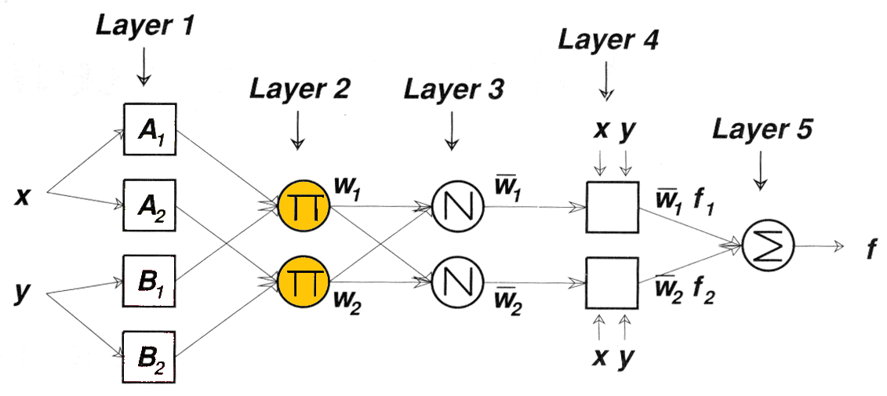
ANFIS Architecture: Layer 2
Every node i in this layer is a fixed node labeled P, whose output is the product of all the incoming signals:
O2,i = Wi = min{mAi (x) , mBi (y)}, i = 1,2
Each node output represents the firing strength of a rule.

Slide 14
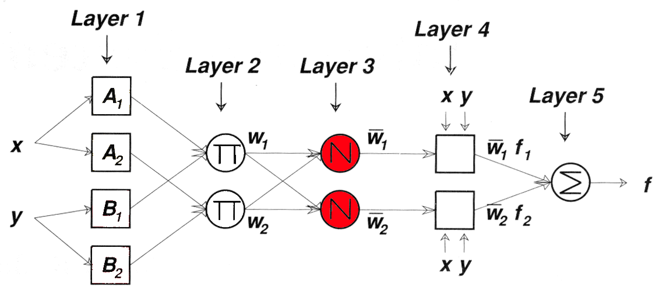
ANFIS Architecture: Layer 3
Every node in this layer is a fixed node labeled N. The ith node calculates the ratio of the ith rule’s firing strength to the sum of all rules’firing stregths:
O3,i = Wi = Wi /(W1+W2) , i =1,2
(normalized firing strengths]

Slide 15
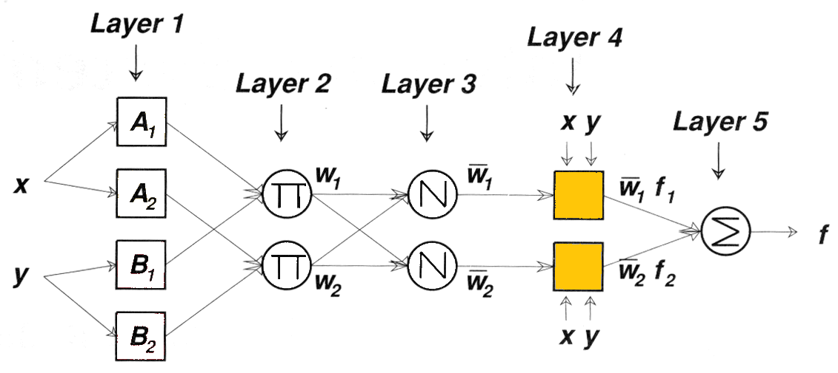
ANFIS Architecture: Layer 4
Every node i in this layer is an adaptive node with a node function
__ __
O 4,i = wi fi = wi (pix + qiy +ri) …Consequent parameters

Slide 16
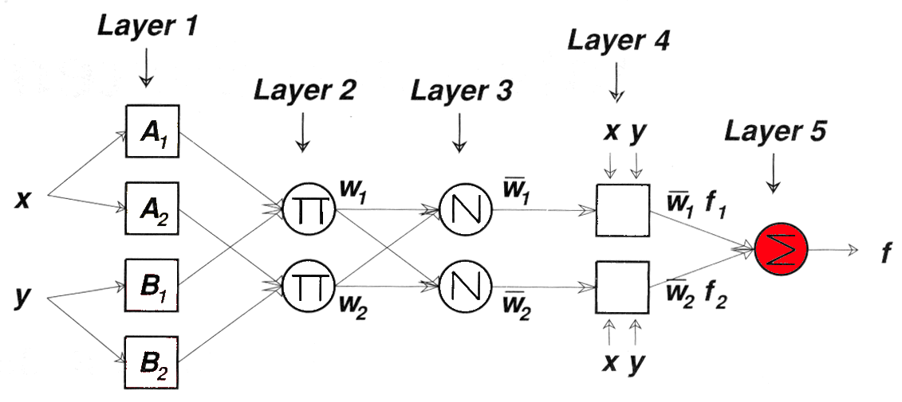
ANFIS Architecture: Layer 5
The single node in this layer is a fixed node labeled S, which computes the overall output as the summation of all incoming signals:
__
O 5,1 = Si wi fi

Slide 17
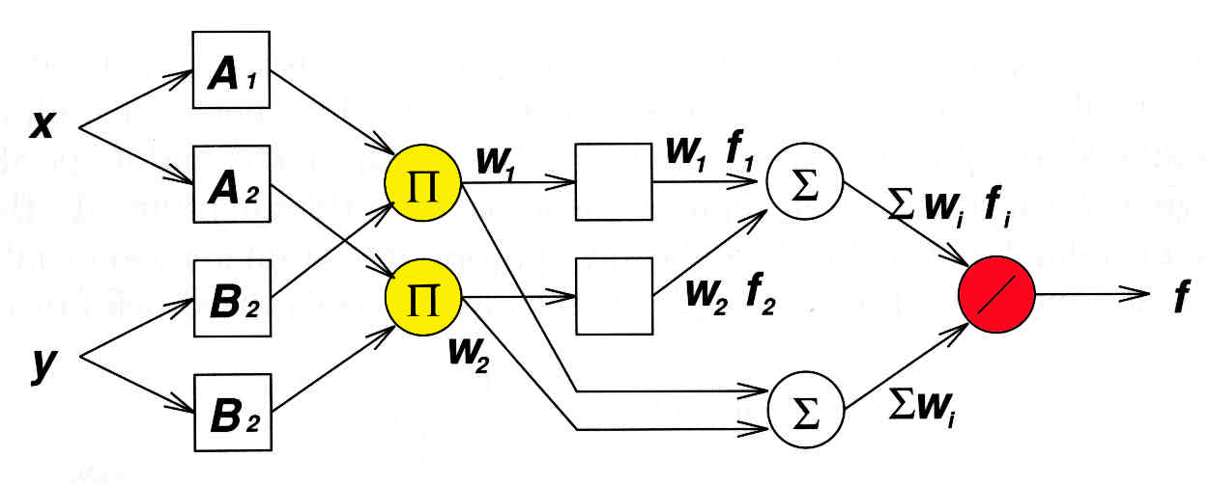
ANFIS Architecture: Alternate
ANFIS architecture for the Sugeno fuzzy model, weight normalization is performed at the very last layer

Slide 18
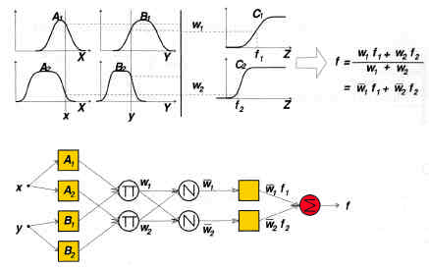
ANFIS Architecture: Tsukamoto model
Equivalent ANFIS architecture using the Tsukamoto fuzzy model

Slide 19
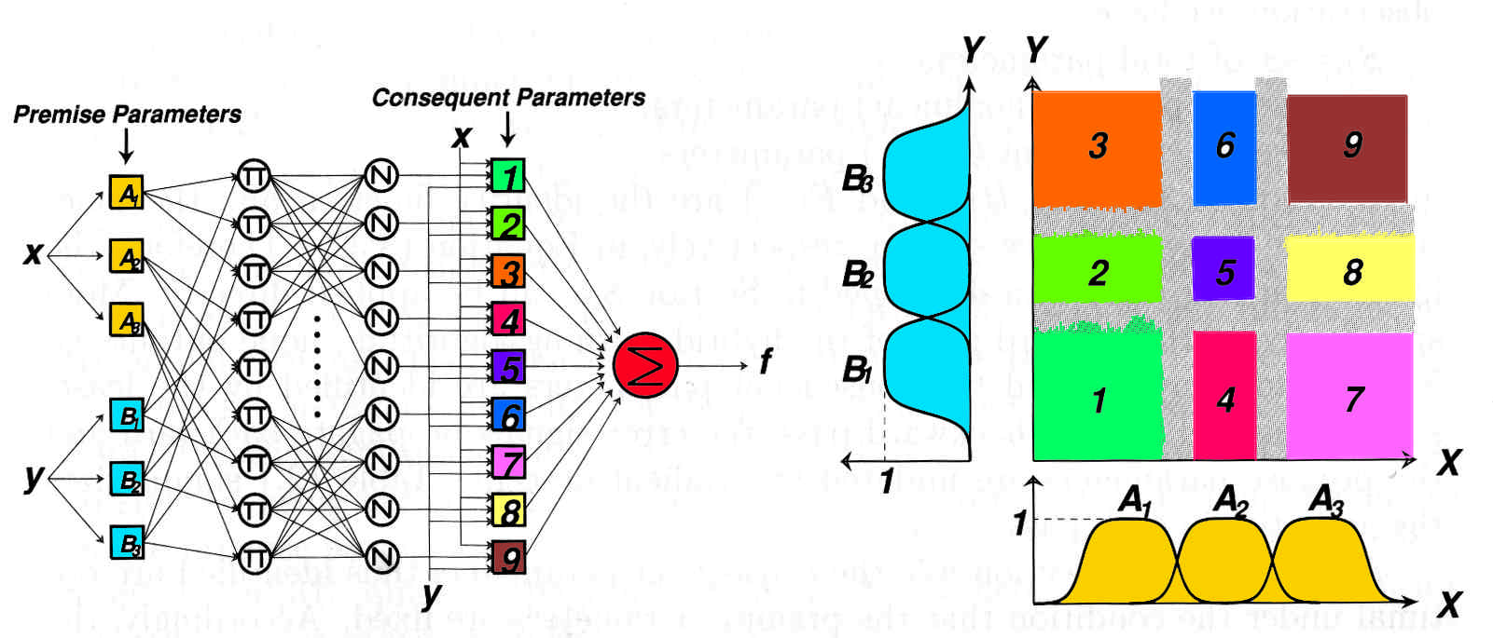
ANFIS Architecture: 2 input Sugeno with 9 rules

